Slide 1
Infinity Music Player
UX Research

Slide 2
Dominant hand

Slide 3
Online research
According to USA today, Adroid forums and stack exchange:
Approximately 70% of smart phone users use their dominant hand.
To confirm this we conducted research on about 20 few students at the Hackathon, all 19 of the students used their dominant hand to hold their phone.
This in tail affected the design and location of the menu button.

Slide 4
Bottom Menu vs Hamburger Menu
95% of the student we interviewed preferred the bottom fixed menu buttons, for the following reasons.
Familiarity
Ease of reach
“I find it easier and quicker to reach the bottom menu vs the Hamburger menu which takes longer to reach”
Made scrolling easier
Increased response time
Hamburger menu had a sleek feel, and more of an iOS feel.

Slide 5
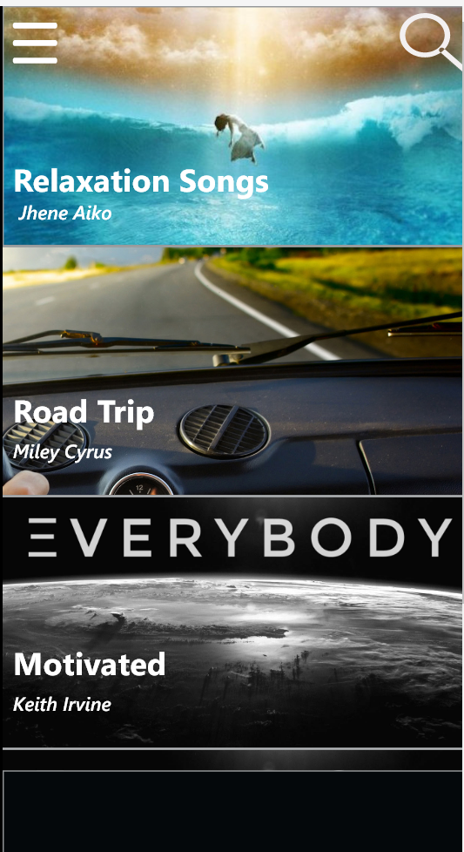
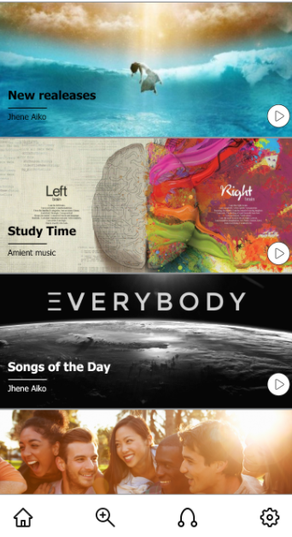

Slide 6
Platform consideration
We decided to use the bottom menu, because of the ease of accessibility.
However also because of the Android Aesthetic and feel that it had.

Slide 8
Color scheme and feel
Goal, to create a simple and elegant interface
Second thing we tested with the prototype was the color scheme.
Color scheme used was chosen because earthy tones, blues and blacks create a simple and calming feel
Infinity scroll feel also chosen to create and smooth flowing feel, inspired by the sky and seamless edge with horizon.

Slide 9
Dark VS Light
Two interfaces created slightly different for a reason.
Comparison between a darker interface with more black or a light interface with more white and open space.
About 75% of the people we interviewed preferred the lighter interface, and found it more calming and relaxing.
The simplicity of the icons was also a factor

Slide 10
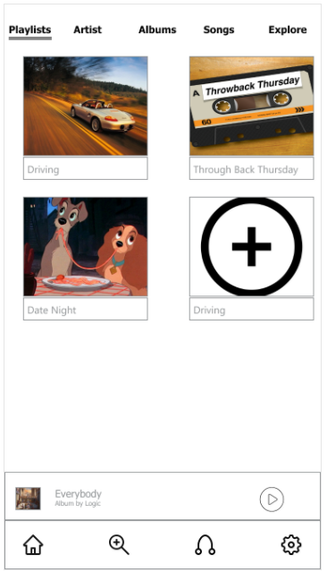
Order of icons according to use
We ran a quick survey to see which icons are used the most. As a result they were placed on the side that could be easily accessible by both left and right handed people.

